Slide 1
ABSTRACTION

Slide 2
Abstract class
A class that is declared with abstract keyword, is known as abstract class in java. It can have abstract and non-abstract methods (method with body).
Before learning java abstract class, let's understand the abstraction in java first.

Slide 3
Abstraction in Java
Abstraction is a process of hiding the implementation details and showing only functionality to the user.
Another way, it shows only important things to the user and hides the internal details for example sending sms, you just type the text and send the message. You don't know the internal processing about the message delivery.
Abstraction lets you focus on what the object does instead of how it does it.
There are two ways to achieve abstraction in java
Abstract class (0 to 100%)
Interface (100%)

Slide 4
Abstract class in Java
A class which is declared as abstract is known as an abstract class. It can have abstract and non-abstract methods. It needs to be extended and its method implemented. It cannot be instantiated.
Points to Remember
An abstract class must be declared with an abstract keyword.
It can have abstract and non-abstract methods.
It cannot be instantiated.
It can have constructors and static methods also.
It can have final methods which will force the subclass not to change the body of the method.
Example of abstract class
abstract class A{}

Slide 5
Abstract Method
A method that is declared as abstract and does not have implementation is known as abstract method.
Example of abstract method
abstract void printStatus();//no body and abstract

Slide 6
Example of abstract class that has abstract method
abstract class Bike{
abstract void run();
}
class Honda4 extends Bike{
void run(){System.out.println("running safely..");}
public static void main(String args[]){
Bike obj = new Honda4();
obj.run();
}
}
Output
running safely..

Slide 7
Example 2:TestBank.java
class TestBank{
public static void main(String args[]){
Bank b;
b=new SBI();
System.out.println("Rate of Interest is: "+b.getRateOfInterest()+" %");
b=new PNB();
System.out.println("Rate of Interest is: "+b.getRateOfInterest()+" %");
}}
abstract class Bank{
abstract int getRateOfInterest();
}
class SBI extends Bank{
int getRateOfInterest(){return 7;}
}
class PNB extends Bank{
int getRateOfInterest(){return 8;}
}
Output
Rate of Interest is: 7 %
Rate of Interest is: 8 %

Slide 8
Abstract class
Abstract class have constructor, data member, methods etc.
An abstract class can have data member, abstract method, method body, constructor and even main() method.

Slide 9
TestAbstraction2.java
class Honda extends Bike{
void run(){System.out.println("running safely..");}
}
class TestAbstraction2{
public static void main(String args[]) {
Bike obj = new Honda();
obj.run();
obj.changeGear(); }
}
//example of abstract class that have method body
abstract class Bike
{
Bike(){System.out.println("bike is created");}
abstract void run();
void changeGear()
{
System.out.println("gear changed"); }
}
output
bike is created
running safely..
gear changed

Slide 10
RULES
Rule: If there is any abstract method in a class, that class must be abstract.
class Bike12
{
abstract void run();
}
Rule: If you are extending any abstract class that have abstract method, you must either provide the implementation of the method or make this class abstract.

Slide 11
Interface in Java

Slide 12
Interface
An interface in java is a blueprint of a class. It has static constants and abstract methods.
The interface in java is a mechanism to achieve abstraction.
There can be only abstract methods in the java interface not method body. It is used to achieve abstraction and multiple inheritance in Java.
Java Interface also represents IS-A relationship. It cannot be instantiated just like abstract class.

Slide 13
Why use Java interface?
There are mainly three reasons to use interface. They are given below.
It is used to achieve abstraction.
By interface, we can support the functionality of multiple inheritance.
It can be used to achieve loose coupling.

Slide 14
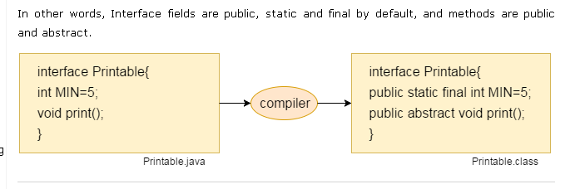
Internal addition by compiler
The java compiler adds public and abstract keywords before the interface method. More, it adds public, static and final keywords before data members.

Slide 15
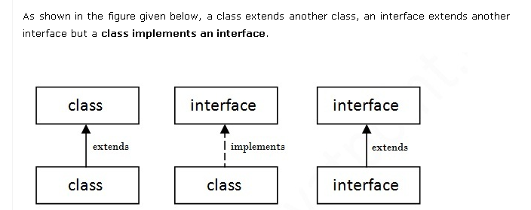
Understanding relationship between classes and interfaces

Slide 16
Java Interface Example: Drawable
//Interface declaration: by first user
interface Drawable{
void draw();
}
//Implementation: by second user
class Rectangle implements Drawable{
public void draw(){System.out.println("drawing rectangle");
}
}
class Circle implements Drawable{
public void draw(){System.out.println("drawing circle");}
}
//Using interface: by third user
class TestInterface1{
public static void main(String args[]){
Drawable d=new Circle();//In real scenario, object is provided by method e.g. getDrawable()
d.draw();
}}

Slide 17
Difference between abstract class and interface
Abstract class | Interface
1) Abstract class can have abstract and non-abstract methods. | Interface can have only abstract methods. Since Java 8, it can have default and static methods also.
2) Abstract class doesn't support multiple inheritance. | Interface supports multiple inheritance.
3) Abstract class can have final, non-final, static and non-static variables. | Interface has only static and final variables.
4) Abstract class can provide the implementation of interface. | Interface can't provide the implementation of abstract class.
5) The abstract keyword is used to declare abstract class. | The interface keyword is used to declare interface.
6) Example: public abstract class Shape{ public abstract void draw(); } | Example: public interface Drawable{ void draw(); }

Slide 18
Questions
Can abstract class have constructors in Java?
Can abstract class implements interface in Java?
does they require to implement all methods? Can abstract class be final in Java?
What will happen if we define a concrete method in an interface?
What will happen if we not initialize variables in an interface
Can we create object for an interface?

Slide 19
Mcqs
1. Determine output of the following code.
interface A { }
class C { }
class D extends C { }
class B extends D implements A { }
public class Test extends Thread{
public static void main(String[] args){
B b = new B();
if (b instanceof A)
System.out.println("b is an instance of A");
if (b instanceof C)
System.out.println("b is an instance of C");
}
}
A. Nothing.
B. b is an instance of A.
C. b is an instance of C.
D. b is an instance of A followed by b is an instance of C.

Slide 20
2. Given the following piece of code:
public interface Guard{
void doYourJob();
}
abstract public class Dog implements Guard{ }
which of the following statements is correct?
A. This code will not compile, because method doYourJob() in interface Guard must be defined abstract.
B. This code will not compile, because class Dog must implement method doYourJob() from interface Guard.
C. This code will not compile, because in the declaration of class Dog we must use the keyword extends instead of implements.
D. This code will compile without any errors.

Slide 21
3. What will be the output?
interface A{
public void method();
}
class One{
public void method(){
System.out.println("Class One method");
}
}
class Two extends One implements A{
public void method(){
System.out.println("Class Two method");
}
}
public class Test extends Two{
public static void main(String[] args){
A a = new Two();
a.method();
}
}
A. will print Class One method
B. will print Class Two method
C. compiles fine but print nothing
D. Compilation Error
E. None of these

Slide 22
4. Which two of the following are legal declarations for abstract classes and interfaces?
1. final abstract class Test {}
2. public static interface Test {}
3. final public class Test {}
4. protected abstract class Test {}
5. protected interface Test {}
6. abstract public class Test {}
A. 1 and 2
B. 2 and 4
C. 3 and 5
D. 5 and 6
E. 3 and 6

Slide 23
5. What will be the output?
1. public interface InfA{
2. protected String getName();
3. }
public class Test implements InfA{
public String getName(){
return "test-name";
}
public static void main (String[] args){
Test t = new Test();
System.out.println(t.getName());
}
}
A. test-name
B. Compilation fails due to an error on lines 2
C. Compilation fails due to an error on lines 1
D. Compilation succeed but Runtime Exception
E. None of these

Slide 24
Answers
1. d
2. d
3. b
4. e
5. b

